Slide 1
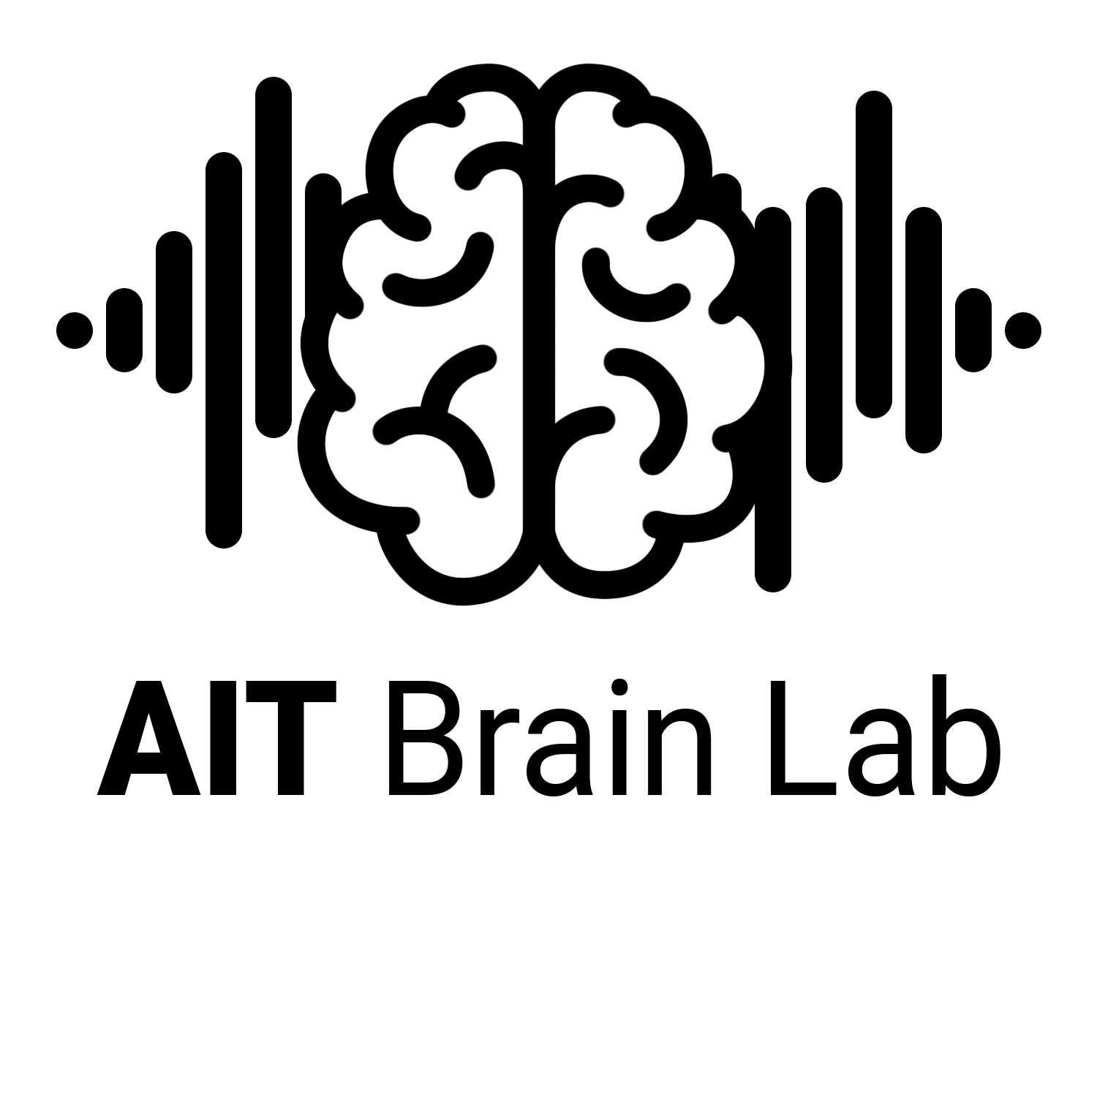
3.4 Multimodal (Vocal-Aware)
1. Core Architecture:
Model: GPT-4o mini (via API)
Role: Central reasoning engine integrating semantic, acoustic,
and prosodic information
2. Feature Injection Strategy:
Text VA (vad-bert): Valence & Arousal from transcript
Speech VA (WavLM): Valence & Arousal from synthesized audio
Vocal Descriptors (librosa): Pitch (F0), Loudness (RMS), Speaking Rate
All injected as contextual descriptors into the LLM prompt
3. Decision Mechanism:
LLM cross-references:
What was said (Text / Semantics)
How it was said (Vocal cues / VA / prosodic descriptors)
-> Holistic response capturing emotional nuances invisible to text-only models

Slide 2
3.4 Dissonance-Aware
1. Core Architecture:
Model: GPT-4o mini (via API)
Role: Same as Multimodal PLUS cognitive dissonance measured from
VA delta between text and speech modalities
2. Feature Injection Strategy:
Text VA (vad-bert): Valence & Arousal from transcript
Speech VA (WavLM): Valence & Arousal from synthesized audio
Vocal Descriptors (librosa): Pitch (F0), Loudness (RMS), Speaking Rate
Dissonance Signal: delta_V = V_speech - V_text, delta_A = A_speech - A_text
Binary Flag: is_dissonant = |delta| >= 0.5
All injected as contextual descriptors into the LLM prompt
3. Decision Mechanism:
LLM cross-references:
What was said (Text / Semantics)
How it was said (Vocal cues / VA / prosodic descriptors)
Why tone differs from words (Dissonance-aware reasoning)
-> Captures hidden affect: when clients voice contradicts their words

Slide 3
INTRODUCTION
In recent years, growing public awareness of mental health has sharply increased the demand for accessible psychological support, accelerating efforts to use large language models (LLMs) as synthetic counseling agents. \cite{lee2024cactus}
Closed-source systems such as GPT-based CBT assistants have already been explored as practical counselors, but they raise substantial concerns about data privacy and third‑party control over sensitive clinical conversations. \cite{raile2024chatgpt,berrezueta2024adhd,hicke2023aita}
However, most CBT-oriented LLM systems remain fundamentally text-only, which prevents them from capturing rich non-verbal cues—such as hesitation, flat or dismissive tone, or sarcastic prosody—that therapists routinely rely on to recognize client resistance in practice. \cite{sun2024beyondtext}
Because these cues are carried in voice and timing rather than lexical content, transcripts can appear cooperative while the client feels differently--this gap between words even when the spoken interaction clearly signals ambivalence or pushback. \cite{sun2024beyondtext}
In CBT, such subtle resistance often arises when clients feel pushed or misunderstood; when the emotional subtext is missed, therapeutic alliance weakens, both human and AI therapists tend to slip into premature advice-giving instead of exploring the client’s underlying emotions, which erodes the therapeutic alliance and reduces treatment efficacy. \cite{kim2025mirror}
Notes:
Text based cbt → too directive → leads to bad therapeutic alliance
เอา

Slide 4
INTRODUCTION
At the same time, recent work in adjacent domains shows that vocal signals provide systematically useful non-verbal information beyond text. Vocal cues such as pitch, loudness, speaking rate, and disfluencies encode uncertainty, confidence, and affect that are invisible in transcripts, and leveraging these cues significantly improves downstream decision-making and emotion recognition compared to text-only baselines. \cite{sun2024beyondtext,wu2025speechcuellm}
Yet, these audio-augmented methods have not been investigated in CBT-style counseling settings where client resistance and therapeutic alliance are central outcomes, leaving it unclear how much vocal information can actually help LLM-based therapists detect and “roll with” resistance. \cite{kim2025mirror,lee2024cactus}
Notes:
Text based cbt → too directive → leads to bad therapeutic alliance
เอา

Slide 5
1.1 RESEARCH QUESTIONS
RQ1 — Dissonance Advantage
Does the Dissonance-Aware therapist framework, which computes emotional mismatch (VA delta) between text and speech, consistently outperform Baseline (text-only), Emotion (text+VA), and Multimodal (text+speech+VA, without dissonance) methods on measurable therapeutic quality metrics?
RQ2 — Backbone Robustness
Is the advantage of the Dissonance-Aware framework robust across different LLM backbones? Specifically, does the dissonance signal provide consistent performance gains when the underlying therapist LLM is changed (e.g., GPT-4o mini vs. DeepSeek V4 Pro vs. other models)?
Notes:
เอา
ทำ Baclgroyund ถึง problem-statement และสรุป MEthtodology ส่าจะทำอะไรบ้าง
Note: แก้ RQ ให้ดูง่ายขึ้น (ใส่วิธีประมินเข้าไปด้วย แบบ เทียบเป็น average change rate กับ baseline model (context only)
)
ลูกค้าใช้เวลากี่ turn (utterance) ถึงจะเริ่มเปลี่ยน vocal–affective state in the user (for example, [sadness, slow] → [mixed, slow]) following each therapist reply?
เทียบเป็น average change rate กับ baseline model (context only)

Slide 6
1.2 HYPOTHESIS
H1 (Vocal Cues -- RQ1):
A multimodal therapist that receives speech-derived emotional features (VA values and vocal prosodic descriptors) will generate responses rated higher on Understanding and Interpersonal Effectiveness compared to a text-only baseline, with the improvement attributed specifically to the vocal modality.
HH2 (CBT Quality -- RQ2):
The Dissonance-Aware therapist, which receives explicit emotional mismatch signals (VA delta and a binary dissonance flag), will achieve higher scores across all seven evaluation metrics—particularly CTRS Collaboration, Guided Discovery, and Focus—compared to both the Baseline and Emotion (Text-Only) conditions.
H3 (Emotional Captioning -- RQ3):
The explicit dissonance signal functions as a form of emotional captioning: the Dissonance-Aware condition will outperform the Multimodal (Vocal-Aware) condition on CTRS metrics, indicating that the delta mismatch signal provides therapeutic value beyond simply having access to both text and speech modalities.
Notes:
เอา

Slide 7
1.3 OBJECTIVES
Objective for RQ1 (Detection):
To construct a multimodal emotional analysis pipeline that independently extracts Valence-Arousal representations from client text (via vad-bert) and synthesized speech (via WavLM), along with vocal prosodic descriptors (pitch, loudness, speaking rate) from the audio waveform.
Objective for RQ2 (Action):
To implement and compare four therapist generation conditions—Baseline, Emotion (Text-Only), Multimodal (Vocal-Aware), and Dissonance-Aware—using identical CBT-oriented LLM prompts, isolating the contribution of each emotional metadata type.
Objective for RQ3 (Impact):
To evaluate the four conditions using GPT-4o as a zero-shot automated judge across seven therapeutic quality metrics (Therapist Skills, Client Alliance, CTRS) averaged over 10 multi-turn CBT dialogues, and to quantify the specific contribution of the dissonance signal to response quality.
Notes:
เอา

Slide 8
1.4 SCOPE
In Scope (What This Research Will Do):
Develop a Framework: Propose and build a multimodal therapist framework that integrates text and speech emotional signals to detect and respond to emotional dissonance in CBT-style dialogue.
Synthetic Dataset: Create and utilize a synthetically generated dataset of 10 multi-turn CBT counseling dialogues produced via CACTUS-style script generation and Zonos TTS synthesis with state-controlled prosody.
Multimodal Condition Comparison: Compare four therapist generation conditions---Baseline, Emotion (Text-Only), Multimodal (Vocal-Aware), and Dissonance-Aware---to quantify the contribution of each emotional signal type.
Automated Evaluation: Assess therapist response quality using GPT-4o as a zero-shot evaluator across seven metrics spanning Therapist Skills, Client Alliance, and the Cognitive Therapy Rating Scale.
Out of Scope (What This Research Will NOT Do):
Not a Clinical Tool: This project is a computer science exploration. The resulting AI is not a medical device and is not intended to replace professional human therapists or provide clinical diagnoses.
No Real Patient Data: For ethical and privacy reasons, this research will not use any real-world patient or clinical data. All training and testing will be performed on the synthetically generated dataset.
Limited to English: The current scope is limited to processing and generating English-language speech based on the available datasets (CACTUS, Zonos).
No Other Modalities: The analysis is strictly focused on vocal and textual information. We will not analyze other cues such as facial expressions or body language.
Notes:
เอา

Slide 9
2. RELATED WORK
AI-driven CBT and Multimodal Interaction
Existing Work:
  The application of AI to deliver Cognitive Behavioral Therapy (CBT) is a promising frontier. Work like Lee et al. (2024a) with the CACTUS dataset shows the feasibility of generating high-quality, text-based therapeutic conversations.
  Syed et al. (2024) found that although 85% of support seekers in an online text-based peer support setting reported high empathy, an existing state-of-the-art empathy model EPITOME assigned an average empathy score of only 1.69 out of 6. This gap highlights how people can genuinely feel cared for while their written messages, stripped of vocal tone and other non-verbal cues, appear almost soulless to a text-only model that fails to recognize their emotional intent.
  To address this empathy gap, Kim et al. (2025) in their MIRROR paper incorporated visual cues (facial expressions) to detect and manage client resistance.
Research Gap & Our Contribution:
  While MIRROR validates using non-verbal cues, it focuses on vision which might requires more resources for setting up the components for the model. Our framework pioneers the use of vocal cues a more accessible and less intrusive modality to bridge the demonstrated empathy gap and trigger real-time, personalized, voice-based micro-interventions.

Slide 10
2. RELATED WORK
Vocal Cues for Mental State Assessment
Existing Work:
  The use of vocal cues as an indicator of mental state is well-established. Cummins et al. (2015) provide a comprehensive review concluding that acoustic features like pitch and speech rate are significantly correlated with depressive states.
  More recently, Sun et al. (2024), in their work "Beyond Text," demonstrated that leveraging vocal cues can enhance the decision-making of LLMs.
  Mitsios et al. (2024) advanced VA-based emotion models (vad-bert, WavLM) for text & speech. framework by Wu et al. (2025), have further shown that vocal features can be effectively translated into natural language descriptions, allowing LLMs to process them without architectural changes.
Research Gap & Our Contribution:
  Wang & Wu (2024) showed MSA models fail on modality-conflicting data. Haydarov et al. (2025) introduced that apply these techniques together for CBT approach. Hence, our work focuses on classifying specific negative cognitive states as defined by CBT (e.g., under-confident, sadness, and cognitive distortion) from vocal patterns, leveraging recent techniques to achieve a deeper level of understanding.

Slide 11
2. RELATED WORK
Voice Modeling for Therapeutic Intervention
Existing Work:
  The feasibility of our proposed intervention relies on recent advancements in Controllable and Expressive Text-to-Speech (TTS) synthesis. State-of-the-art models have demonstrated the ability to clone a speaker's voice and generate highly realistic, human-like speech.
  Furthermore, research by Reza et al. (2024) confirms that acoustic features are strongly correlated with speaker demographics, underscoring the necessity of demographic diversity for creating realistic training data.
Research Gap & Our Contribution:
  The application of these models in a therapeutic context is under-explored. Our research investigates using this technology not just to create realistic speech, but to generate a demographically diverse set of voices and control their emotional expression in real-time to deliver empathetic and therapeutically appropriate vocal responses as a core part of the intervention loop.

Slide 12
3.2 DATASET: How We Built the Dataset
The Structural Foundation (Inspired by CACTUS)
Agentic Role-Play: The CACTUS framework simulate realistic counseling sessions using LLM agents (Counselor vs. Client).
"Script-Mode" Generation: Instead of simple turn-by-turn generation, we utilized the Script Mode technique (generating dialogue as a continuous screenplay).
  Why? Research indicates this method yields significantly more natural, coherent, and fluid interactions compared to two-agentic method.
The Vocal Intelligence Layer (Inspired by SpeechCueLLM)
Beyond Text generation: We integrated the SpeechCueLLM methodology to make the LLM "hear" its own script.
State Direction & Prosody: The model doesn't just generate text; it simultaneously analyzes and assigns:
  Emotional State: (e.g., Sadness, Anger, Mixed)
  Visual/Vocal Cues: (e.g., Low Pitch, Slow Rate, Low Loudness)
The Synthesis (Zonos Integration):
These generated State Directions act as the direct control signals for the Zonos TTS engine, ensuring the final audio perfectly matches the psychological context intended by the script.
The Dual-Validation System
Voice analysis (Style Check): Used Whisper-Large-Audio-Captioning to describe the emotional tone of the generated audio (e.g., "A male speaker with a melancholic tone").
Transcript Verification (Content Check): Used Whisper-Large-V3 to transcribe the audio back to text.

Slide 13
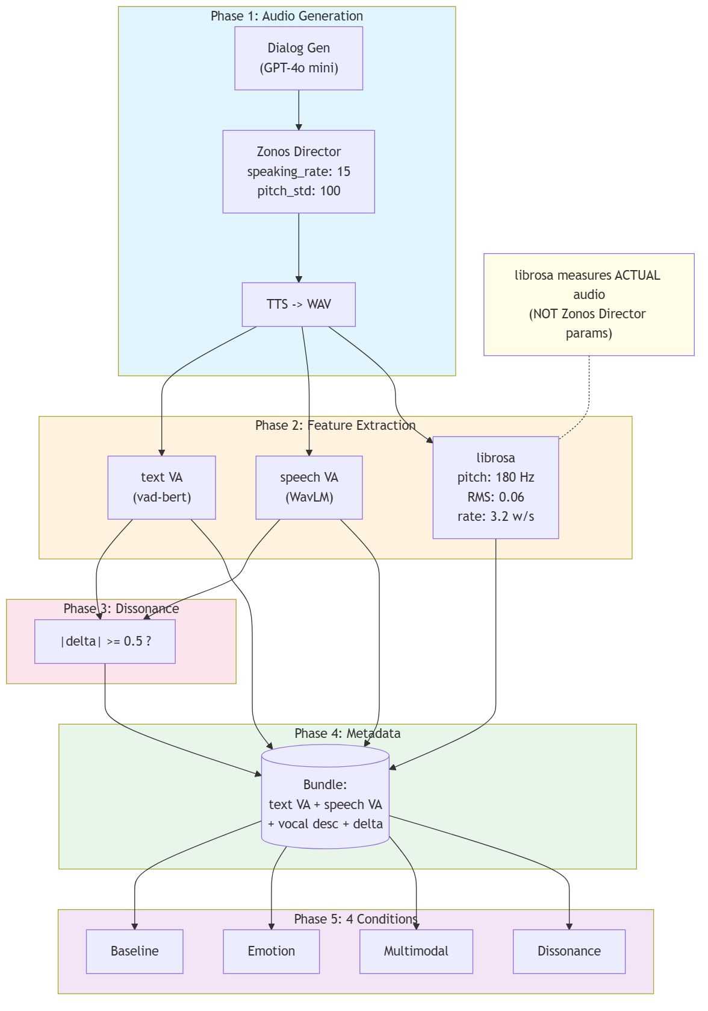
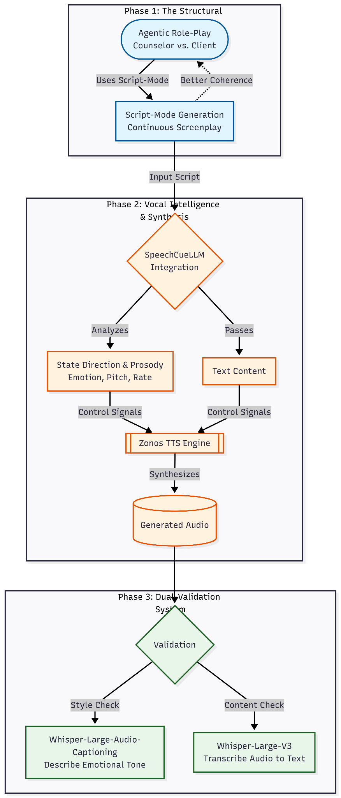
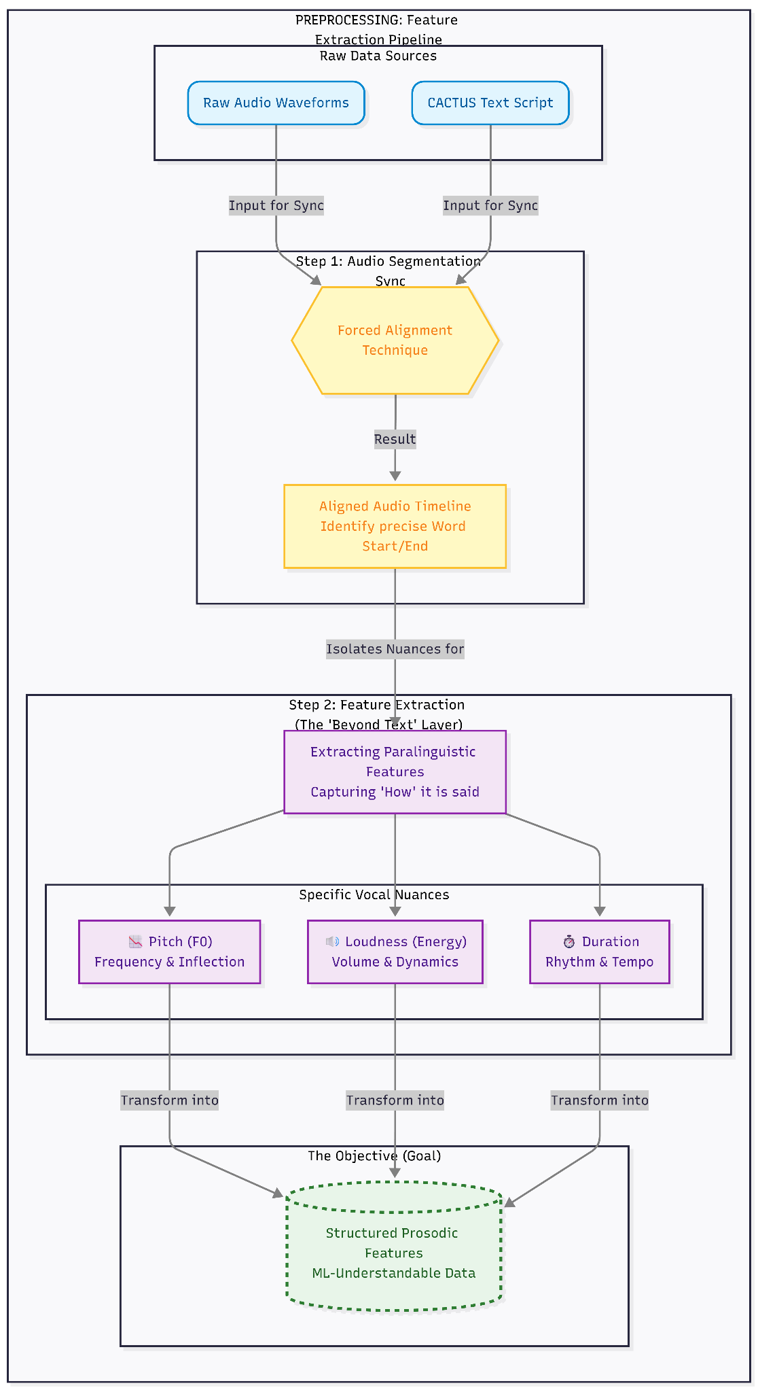
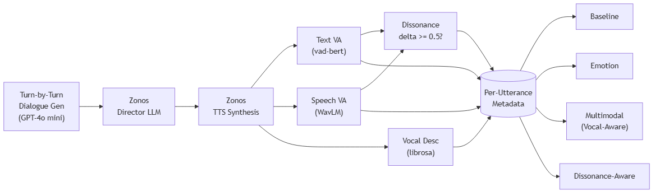
3.2 FRAMEWORK: DATASET & PREPROCESSING PIPELINE

Slide 14
3.3 PREPROCESSING: Feature Extraction
1. The Objective:
Transform raw audio into structured prosodic features representing emotional state.
Make unstructured audio understandable for the therapist generation pipeline.
2. The Pipeline:
Step 1: Audio Segmentation
Segments audio into utterance-level chunks using Zonos synthesis boundaries.
Isolates each client utterance for independent feature extraction.
Step 2: Dual-Channel Emotion Extraction (vad-bert + WavLM + librosa)
Text VA (vad-bert): Valence & Arousal from transcript
Speech VA (WavLM): Valence & Arousal from audio waveform
Vocal Descriptors (librosa): Pitch (F0), Loudness (RMS), Speaking Rate
e.g. pitch: 180 Hz, RMS: 0.06, rate: 3.2 w/s (ACTUAL audio measurement)
NOT Zonos Director pre-synthesis targets (speaking_rate: 15, pitch_std: 100)
Step 3: Dissonance Computation
delta_V = V_speech - V_text, delta_A = A_speech - A_text
Flag dissonance if |delta| >= 0.5 in either dimension
Use as therapeutic signal: hidden affect -> gentle exploration

Slide 15
3.4 Models for Therapist Generation
Baseline (Text-Only)
Model Architecture:
Large Language Model (LLM): Utilized GPT-4o mini via API.
Input Data:
Context-Only: Receives pure text transcripts of the dialogue history (e.g., previous turns + current client utterance).
Blind to Audio: Crucially, this model has zero access to acoustic features (pitch, loudness, speed).
Objective:
To establish the "Text-Only Performance Ceiling".
This represents how well a state-of-the-art AI can understand the client's cognitive state using semantic content alone, serving as the benchmark to measure the added value of vocal cues.

Slide 16
3.4 Therapist Generation Conditions
Emotion (Text-Only + VA) (The Text-Only with VA outputs)
Model Architecture:
Large Language Model (LLM): Utilized GPT-4o mini via API.
Input Data:
Context-Only with VA added: Receives pure text transcripts of the dialogue history (e.g., previous turns + current client utterance) + valence and arousal values to guide the LLM to understand the current emotional state more clearly.
Blind to Audio: Crucially, this model still has zero access to acoustic features (pitch, loudness, speed).
Objective:
To establish the "Text-Only with the addition of VA values Performance Ceiling".
This represents how effective of LLMs response via added VA values to LLMs that could help in more emphatic feel for the client's cognitive state compared to the baseline model.

Slide 17
3.4 Therapist Generation Conditions
Multimodal (Vocal-Aware) (Vocal-Aware LLM Framework)
1. Core Architecture:
Model: GPT-4o mini (accessed via API).
Role: Acts as the central reasoning engine that integrates both semantic and acoustic information.
2. The Innovation (Input Fusion):
Instead of processing audio separately with a complex neural network (like LSTM), we adopt a "Feature Injection" strategy.
Process:
  Extraction: Raw audio is processed to extract key prosodic features (Pitch, Loudness, Speaking Rate).
  Transformation: These numerical features are converted into Contextual Descriptors (e.g., "High Pitch", "Rapid Speech", or normalized values).
  Fusion: These acoustic descriptors are appended directly into the LLM's System Prompt alongside the dialogue text.
3. Decision Mechanism:
The LLM analyzes the Cognitive State by cross-referencing:
  What was said (Text/Semantics)
  How it was said (Vocal cues)
Result: A holistic prediction that captures emotional nuances invisible to text-only models.

Slide 18
3.4 Therapist Generation Conditions
Dissonance-Aware (Dissonance-Aware LLM Framework)
1. Core Architecture:
Model: GPT-4o mini (accessed via API).
Role: Acts as the central reasoning engine that integrates both semantic and acoustic information with details of cognitive dissonance measured from delta of VA between modalities (text, speech).
2. The Innovation (Input Fusion):
Instead of processing audio separately with a complex neural network (like LSTM), we adopt a "Feature Injection" strategy.
Process:
  Extraction: Raw audio is processed to extract key prosodic features (Pitch, Loudness, Speaking Rate).
  Transformation: These numerical features are converted into Contextual Descriptors (e.g., "High Pitch", "Rapid Speech", or normalized values).
  Fusion: These acoustic descriptors are appended directly into the LLM's System Prompt alongside the dialogue text.
3. Decision Mechanism:
The LLM analyzes the Cognitive State by cross-referencing:
  What was said (Text/Semantics)
  How it was said (Vocal cues)
  Why the expression tone differs from word meaning (Dissonance aware cues)
Result: A holistic prediction that captures emotional nuances invisible to text-only models and original text+speech multimodal model.

Slide 19
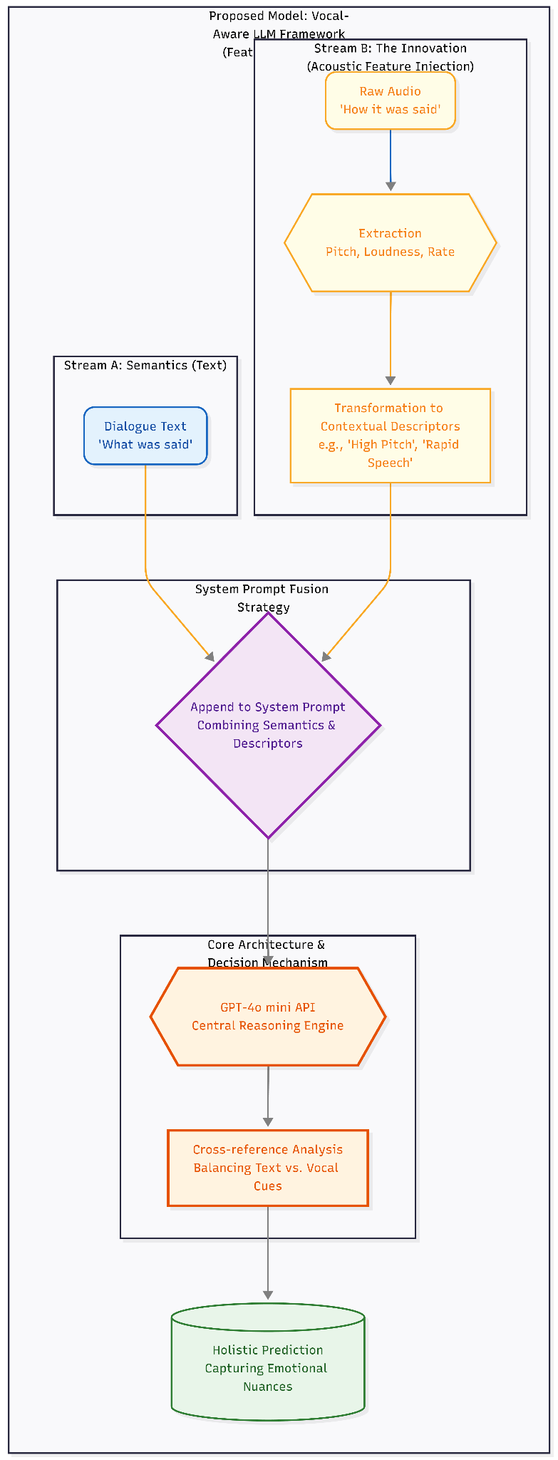
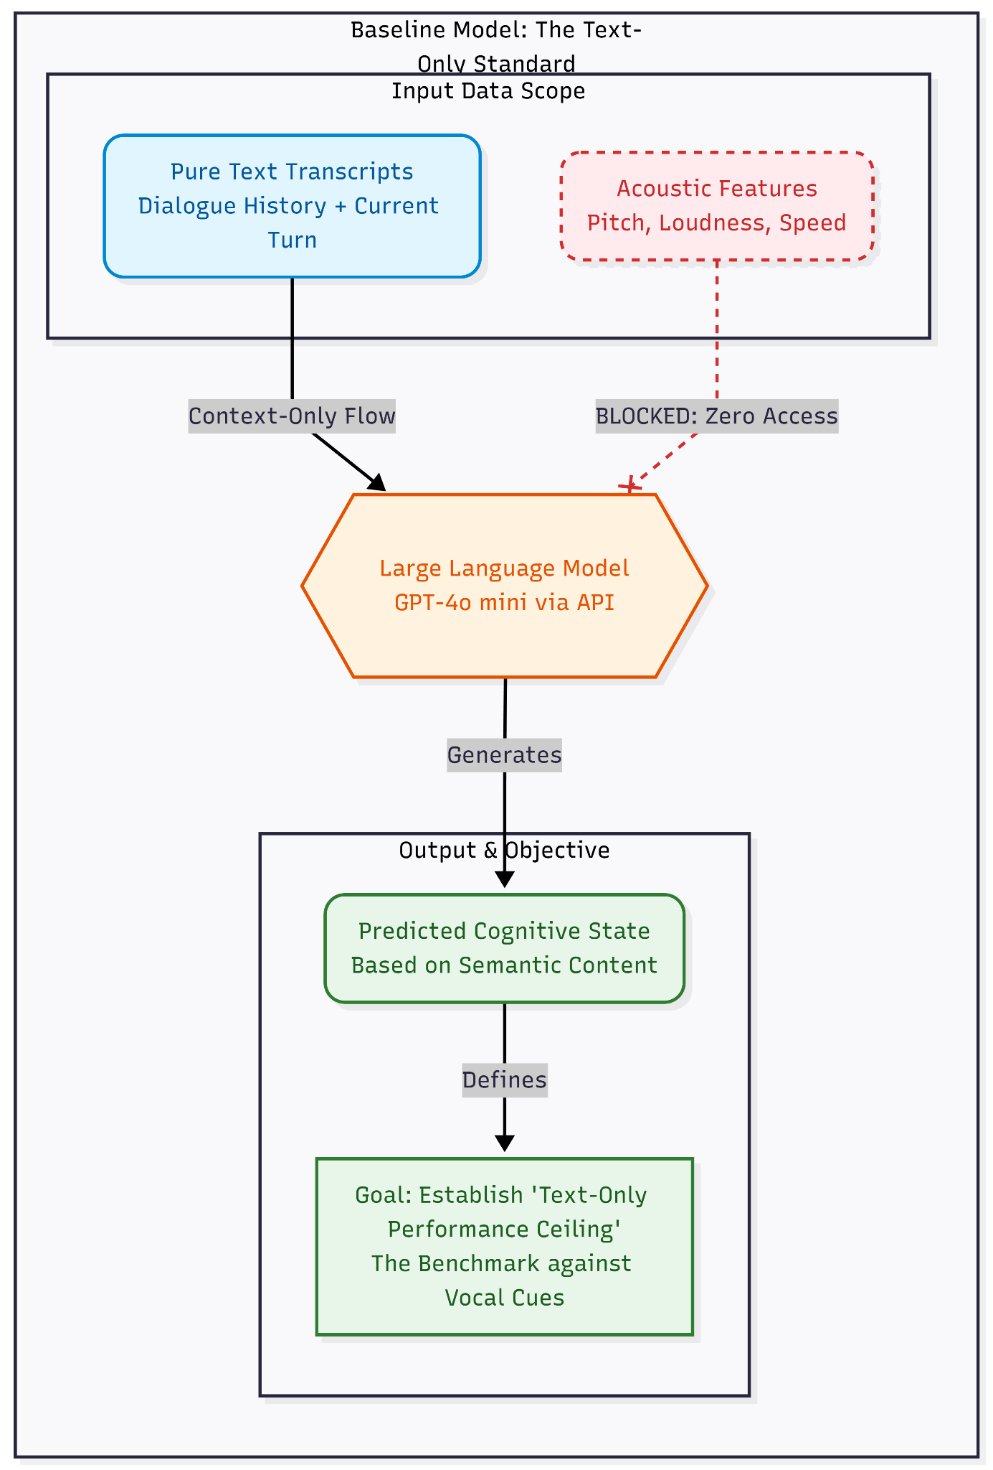
3.4 FRAMEWORK BASELINE MODEL AND T+A MULTIMODAL

Slide 20
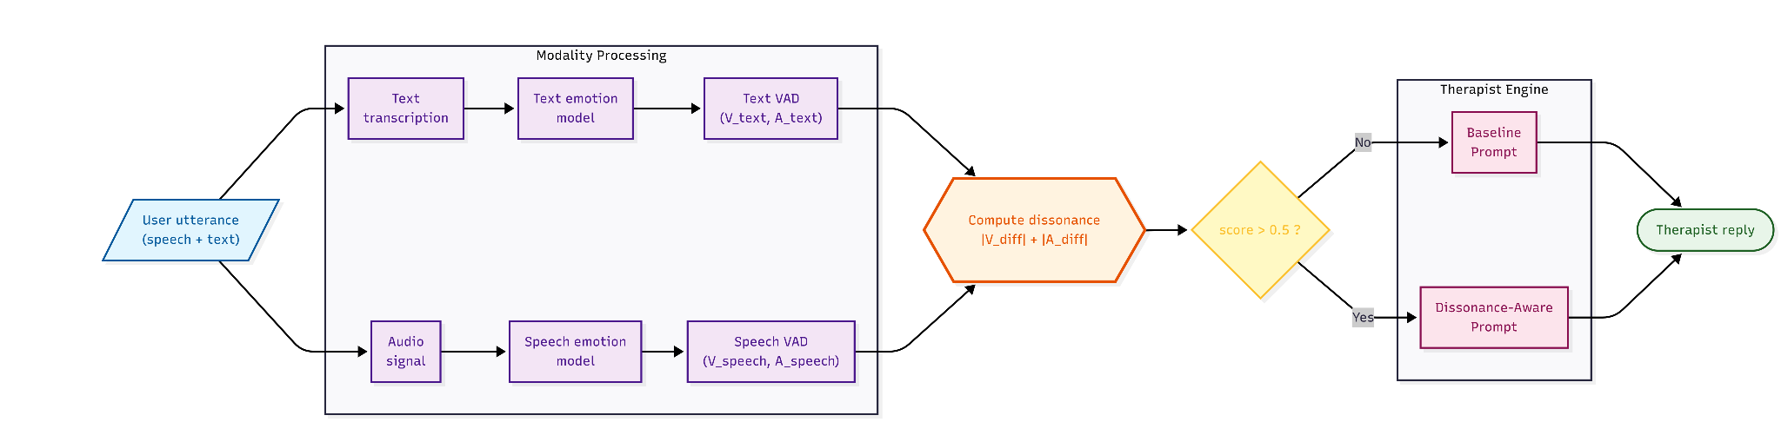
3.4 FRAMEWORK DISSONANCE AWARE MODEL

Slide 21
4. EXPERIMENTS
Therapist Response Quality Evaluation
Experimental Design:
• 10 CBT dialogues x 4 therapist generation conditions = 40 evaluation sessions
• Same client utterances across all conditions → controlled comparison
• GPT-4o as zero-shot judge, temperature = 0.0, blind to condition
• 7 metrics across 3 dimensions: Therapist Skills, Client Alliance, CTRS
Results (Average Scores Across 10 Dialogues):
Method | Under. | Interp. | Affect. | CTRS-C | CTRS-G | CTRS-F | CTRS-S
Baseline | 4.00 | 4.40 | 3.45 | 3.10 | 2.60 | 3.00 | 2.60
Emotion (Text) | 4.10 | 5.00 | 4.00 | 4.00 | 3.10 | 3.40 | 3.10
Multimodal (Vocal) | 4.30 | 5.00 | 4.00 | 3.90 | 3.10 | 3.40 | 3.10
Dissonance-Aware | 4.90* | 5.00 | 4.00 | 4.50* | 3.90* | 4.50* | 3.70*
* Dissonance-Aware dominates all 7 metrics. Largest gains: +1.50 Focus, +1.40 Collab, +1.30 Guided.

Slide 22
4. EXPERIMENTS
Evaluation Protocol: GPT-4o Zero-Shot Judge
GPT-4o Evaluation Setup:
• Receives full session transcript (all client + therapist turns concatenated)
• Blind to experimental condition → no evaluation bias
• Required to output structured JSON with all 7 metric scores
Evaluation Dimensions & Metrics:
Therapist Skills (0-6): Understanding | Interpersonal Effectiveness
Client Alliance (1-5): Affective Bond
CTRS (0-6 each): Collaboration | Guided Discovery | Focus | Strategy
Key Findings:
• Dissonance-Aware wins 6/7 metrics vs Baseline/Emotion/Multimodal
• Largest gains: CTRS Focus (+1.10) and CTRS Collaboration (+1.20) over Baseline
• Multimodal (Vocal-Aware) ≈ Emotion on alliance, but drops on CTRS
• Dissonance signal itself drives improvement, not just multimodal input

Slide 23
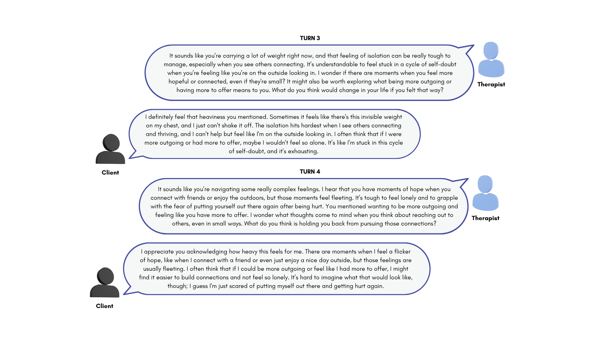
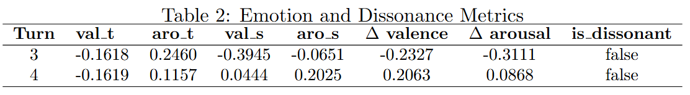
5. CHAT EXAMPLE BETWEEN THERAPIST & CLIENT

Slide 24
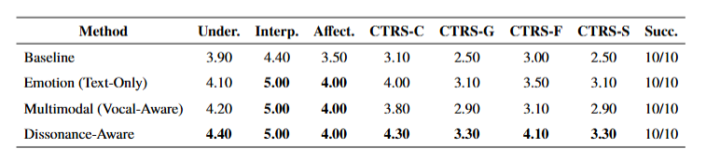
5. KEY FINDINGS
Dissonance-Aware dominated all 7 metrics:
• Understanding: 4.90 (Baseline: 4.00, +0.90)
• CTRS Focus: 4.50 (Baseline: 3.00, +1.50) ← Largest gain
• CTRS Collab: 4.50 (Baseline: 3.10, +1.40)
• CTRS Guided: 3.90 (Baseline: 2.60, +1.30)
• CTRS Strategy: 3.70 (Baseline: 2.60, +1.10)
Multimodal (Vocal-Aware) shows clear improvement:
• Understanding: 4.30 vs Emotion 4.10 → vocal cues add value
• CTRS metrics match or slightly exceed Emotion (Text-Only)
Core Finding:
The dissonance signal itself is the key driver of improved
therapeutic attunement in CBT-oriented LLM responses.

Slide 25
6. DISCUSSION
FOR FINAL DEFENSE ONLY

Slide 26
6. DISCUSSION - REVISIT RESEARCH QUESTIONS
FOR FINAL DEFENSE ONLY

Slide 27
7. DEMO
FOR FINAL DEFENSE ONLY

Slide 28
TENTATIVE WORK PLAN
2025
2026
JUN
JUL
AUG
SEP
OCT
NOV
DEC
JAN
FEB
MAR
APR
MAY
JUN
JUL
Literature Review
Proposal Defense
Development
Experiment
Progress Defense
Analysis
Writing
Publication
Final Defense

Slide 29
REFERENCES
[1] Cummins et al. (2015). A Review of Depression and Suicide Risk Assessment Using Speech Analysis. Speech Communication.
[2] Lee et al. (2024). CACTUS: Towards Psychological Counseling Conversations using CBT. arXiv:2407.03103.
[3] Shahrokhian et al. (2021). The Effects of CBT in Well-Being and Perceived Stress. Int J Sport Studies Health.
[4] Sun et al. (2024). Beyond Text: Improving LLMs via Vocal Cues. (Proc. Conference).
[5] Thirunavukkarasu et al. (2024). Deep Multimodal Fusion for Depression Detection. ACCAI 2024.
[6] Mitsios et al. (2024). Improved Text Emotion Prediction Using Combined VA Ordinal Classification. NAACL 2024.
[7] Kim et al. (2025). MIRROR: Multimodal Cognitive Reframing Therapy. EMNLP 2025.
[8] Yan et al. (2024). Talk With Human-like Agents: PerceptiveAgent. ACL 2024.
[9] Wang & Wu (2024). Evaluation of Data Inconsistency for Multi-Modal Sentiment Analysis. arXiv:2406.03004.
[10] Haydarov et al. (2025). Towards AI-Assisted Psychotherapy: Emotion-Guided Generative Interventions. EMNLP 2025.

Slide 30
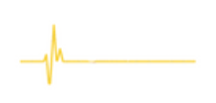
THANK YOU
for your attention

